Slide 1
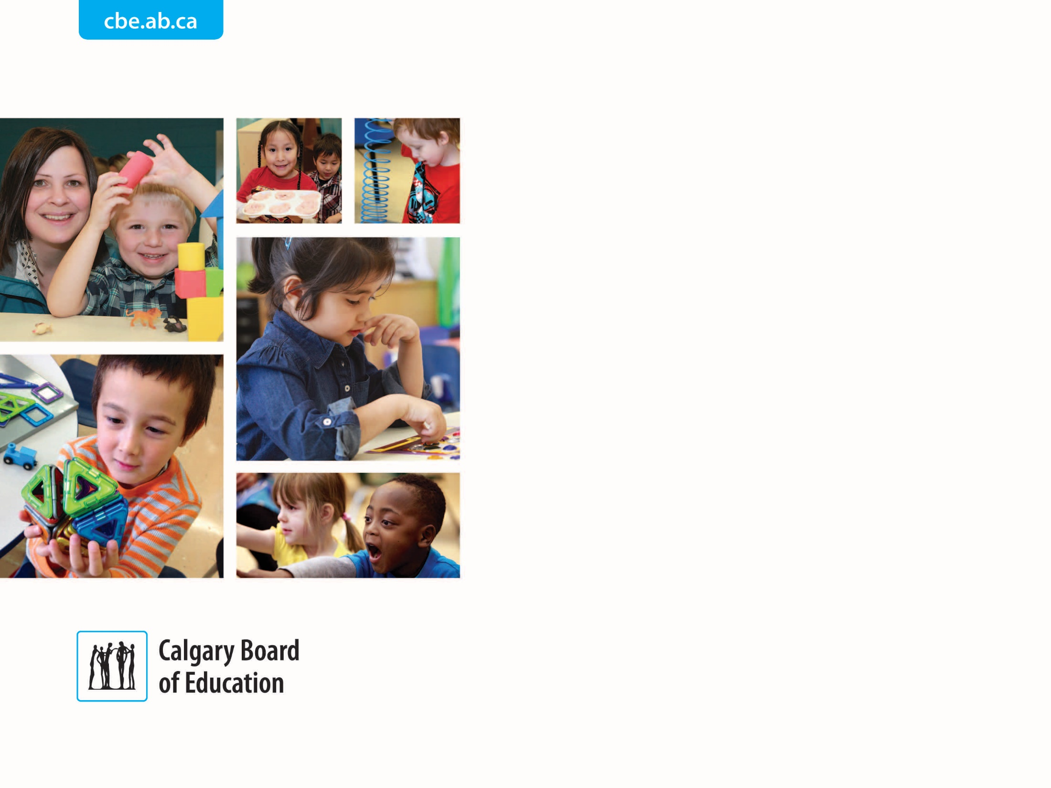

Kindergarten
École Tuscany School

Slide 2

Acknowledging the Land
Notes:
Samantha
As we begin tonight, we will Acknowledge the Land where we gather.
Oki (Oak-key),
Dādánast’áda (Dada-nast-adah),
Âba wathtec (Amba-wastitch),
Tânisi (Tawn-say),
Taanishi (Tawn-i-shi),
Bonjour, Hello
The Calgary Board of Education acknowledges the traditional territories and oral practices of the Treaty 7 Nations, including the
Siksikaitsitapi (Sig-sig-kaits-sits-a-pi) Nations,
Tsuut'ina (Soot-tenna) Nation,
and the
Îyârhe Nakoda (Ae-yar-hay Na-koh-da) Nations.
We acknowledge the
Métis (May-tee) Nation within Alberta,
and all people who make their homes in the Treaty 7 region of southern Alberta. As a learning organization, we are committed to advancing the Truth and Reconciliation Calls to Action focused on Education for Reconcili-ACTION.

Slide 3

Agenda
Welcome to École Tuscany School and Introductions
Early Years Education
Getting Ready for Kindergarten
Neurolinguistic Approach to second language learning
Calgary Board of Education Kindergarten Registration
  Processes specific to English and French Language Programs
Transportation
Welcome to Kindergarten Event - May 2025
Notes:
Lesley
Thank you Samantha for the land acknowledgement.
Introduce self, Laura, Jessica and Samantha
Review agenda points

Slide 4
Tuscany Together/Tuscany Ensemble
Welcome to our dynamic Learning Community!
English Programming
  Kindergarten – Grade 5
French Immersion Programming
  Kindergarten – Grade 5
Enhanced Education Supports (EES)
  Grades 1-6
Notes:
Laura
We serve 590+ Students this school year
We offer diverse programming through an English Program, French Immersion Program and Enhanced Education Supports programing.
We are fortunate to have three programs and we are ONE school community.
After grade 5, students in our English program are designated to Twelve Mile Coulee Middle School
After grade 5, students in our French immersion program are designated to F. E. Osborn Middle School for continuing FI programming

Slide 5

Kindergarten Hours (to be confirmed in May)
Monday through Thursday
8:27-11:15 for morning class students
12:07-2:55 for afternoon class students
Alternating Fridays
8:27-12:40
Notes:
Laura
At Ecole Tuscany School we offer HALF DAY Kindergarten programming.
Currently, our Kindergarten hours are:
8:27-11:15 for morning class students
12:07-2:55 for afternoon class students
Monday through Thursday
Kindergarten children also attend from 8:27-12:40 on alternating Fridays. So the afternoon class students will attend in the morning on some Fridays. We will provide you a list of those dates.
There may be changes to these hours for next year.

Slide 6
Early Years Education
The early years are a time of significant development in a child’s life and personalized attention is beneficial to early learners.
At École Tuscany School, we recognize that each child brings their own unique talents and gifts to their learning experiences.
Our dedicated staff know how to help each child reach their full potential.
Notes:
Laura
What is known as ‘the early years’ (from a child’s birth through age 8) is an important time in a child's life.
Kindergarten children learn about formal schooling and develop strategies for ways to interact in the school setting with peers and teachers.
Kindergarten is the time when children learn critical social and emotional skills. In Kindergarten, the first year of school, is when very important partnerships can formed between the child and their teachers, and, between the family and school.
When these relationships are positive and successful, the opportunity for continuing a positive and successful educational journey is developed.
This is also an important time to notice any specific developmental areas where a child may need a boost or some extra support. Early intervention is critical for a child’s long-term success so if the teacher notices an area where a child might need additional supports, they will let parents know.
We are so fortunate to have very skilled and experienced kindergarten teachers at Ecole Tuscany School!

Slide 7

Learning Through PLAY
More than just skill building or practicing for the world we will grow into, play is the primary way which children manipulate new information, fit it into existing schema or create new ones and then adjust their understanding accordingly.
formulating hypothesis
engaging in experimentation and exploration
discovering patterns
creating theories
Notes:
Samantha
At Ecole Tuscany School, we work to provide developmentally appropriate programming and personalized learning for all Kindergarten children.
We work to build on each child's unique strengths and areas for growth - this includes offering children a wide range of play-based learning opportunities designed to develop their social/emotional skills, early literacy and numeracy skills, and fine & gross motor skills.

Slide 8

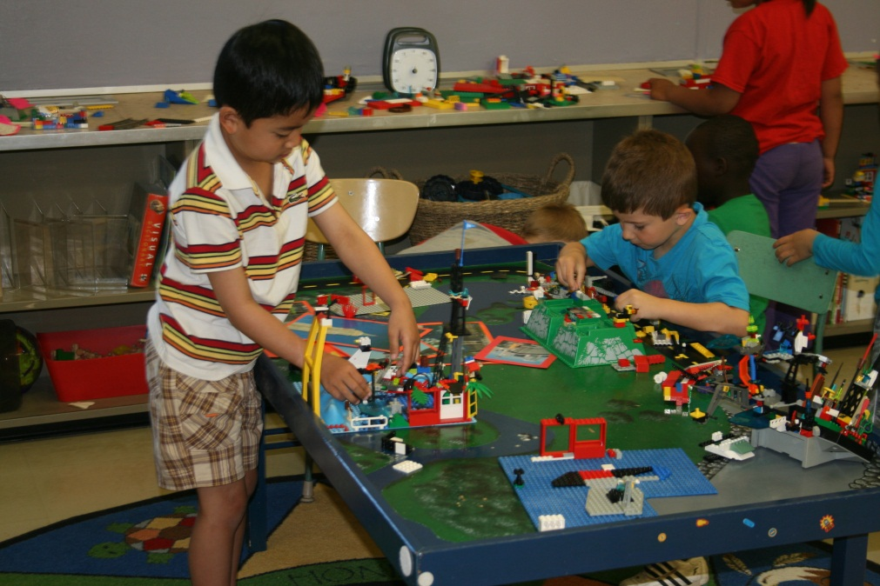
Learning Through PLAY
Notes:
Samantha
Through play, children learn:
symbolic thinking (meta-linguistic awareness)
self-regulation
emotional thinking
oral language skills
foundational literacy and numeracy concepts/skills
new social skills and experience opportunities for friendship building
Our teachers ensure that they design learning opportunities and tasks for kindergarten children which are open ended and provide rich learning experiences.

Slide 9
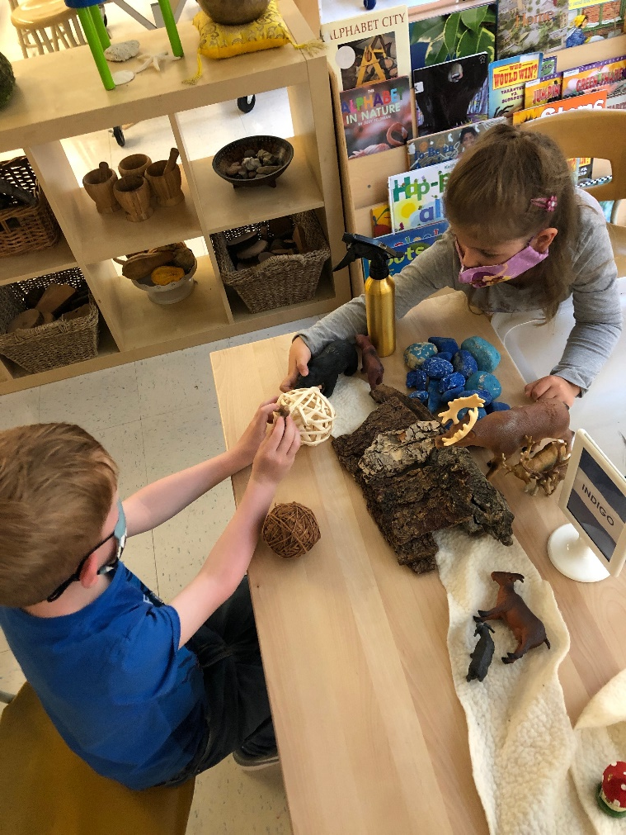
Learning Through PLAY
“Research shows that children who engage in complex forms of socio-dramatic play have greater language skills than non-players, better social skills, more empathy, more imagination, and more of the subtle capacity to know what others mean. They are less aggressive and show more self-control and higher levels of thinking”
-Miller & Almon
Notes:
Samantha
Play is such a valuable way to engage in learning.
Research shows that children who engage in complex forms of dramatic play build strong language skills, develop empathy, build their imaginations, and more are better able to understand peers and teachers.
This quote is from the summary and recommendations of the Alliance for Childhood report by Miller and Almon - Crisis in the Kindergarten (2009), Page 2

Slide 10
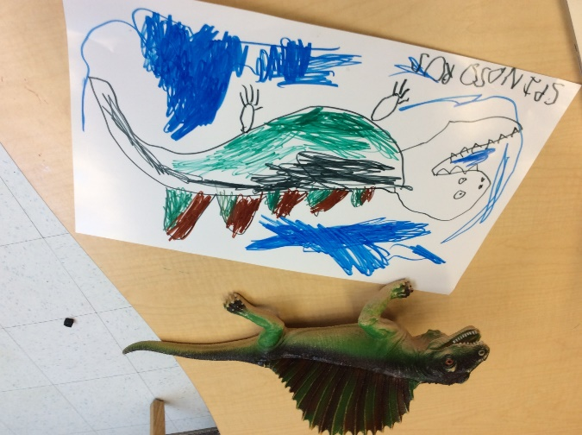
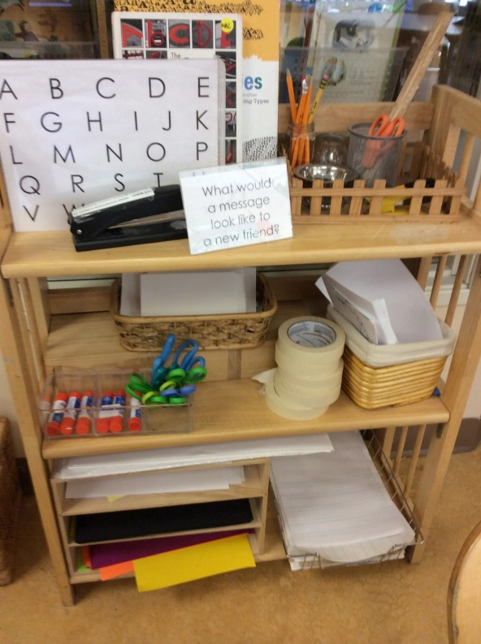
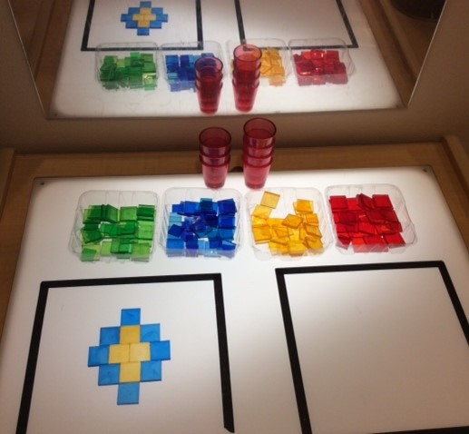
Early Literacy & Numeracy
Notes:
Samantha
Developing strong oral language skills and number sense is a large part of the kindergarten curriculum and is foundational to future reading, writing and mathematics skill development.
In kindergarten, both literacy and numeracy outcomes are addressed through a combination of direct teaching and intentionally designed play-based centres.
This first year of formal schooling gives us the honor to help children to engage in our learning community in a joyful way and build the foundation for loving school and becoming life-long learners.
--------------------------------------------------------------------------------------------------------------------------------------
Literacy
**Slide info from Welcome to Kindergarten
--------------------------------------------------------------------------------------------------------------------------------------
Number sense is a person’s ability to understand, relate, and connect numbers.
Children with strong number sense think flexibly and fluently about numbers.
They can:
Visualize and talk comfortably about numbers. Number bonds are one tool to help them see the connections between numbers.
Take numbers apart and put them back together in different ways — e.g. breaking the number five down several times (such as: 5+0=5; 4+1=5; 3+2=5; 2+3=5; 1+4=5; 0+5=5 and so on), which helps your children learn all the ways to make five.
Compute mentally — solving problems in their heads instead of using a paper and pencil.
Relate numbers to real-life problems by connecting them to their everyday world. For instance, asking how many apples they've picked at a farm. ("Andy picked 5 apples. Amanda picked 2. How many apples did they pick in all?")
Number sense is so important for your young math learners because it promotes confidence and encourages flexible thinking.

Slide 11

Getting Ready for Kindergarten
Build your child’s independence by encouraging them to:
dress themselves (zippers, buttons, putting on shoes/boots)
use the bathroom and wash their hands on their own
put away toys and help in other small ways at home
practice opening/closing snack containers and using a water bottle
play games, take turns, share and compromise
develop a consistent bedtime routine
Notes:
Jessica
Kindergarten is a joyful and active learning environment. Helping your child to develop some of these self care, independence and social skills is important for their success at school.

Slide 12
Getting Ready for Kindergarten
Read aloud to your child every day:
read stories together in your home language to help your
child develop vocabulary, listening and speaking skills
enjoy reading different types of books: picture books,
information books, nursery rhymes, poetry
encourage your child to talk about the pictures and stories
as you read together
visit your community library
Notes:
Jessica
Speaking and reading in your home language provides a solid foundation for all language acquisition.

Slide 13
Getting Ready for Kindergarten
Make time to talk with your child about everyday activities:
share special activities together, such as walks to the park
talk about what you are seeing and doing
talk, read, sing and play in your home language every day
praise children for their efforts and courage to overcome setbacks
talk about how it is okay to make mistakes and that this is how we all learn
Notes:
Jessica
Oral language development is the foundation to almost all other learning. Help your child to build a rich vocabulary through back and forth conversations.

Slide 14
Additional Resources for Families
Ideas for Parents: https://www.cbe.ab.ca/programs/kindergarten/Documents/Ideas-for-Parents.pdf
The Calgary Public Library Top Tips for Kindergarten Readiness:
https://calgarylibrary.ca/library-news/kitchen-table-classroom-kindergarten-readiness/
The Calgary Public Library Kindergarten Booklist: https://calgary.bibliocommons.com/list/share/393767397_calgarylibrary_kids/1859193931_books_to_get_ready_for_kindergarten?_ga=2.167944481.1601611572.1619640025-939542020.1599601380
I’m Ready book: Parent Resource: https://calgaryreads.com/wp-content/uploads/2020/02/F2KD_ImReadyBooklet_GENERIC.pdf
I’m Ready for Screens book - Parent Resource: https://banff.ca/DocumentCenter/View/11018/ImReadyForScreens_English
Notes:
Jessica
We have compiled a number of resources which can be helpful for parents. Laura will put those in the chat for you
Ideas for parents: https://www.cbe.ab.ca/programs/kindergarten/Documents/Ideas-for-Parents.pdf
The Calgary Public Library offers a special library card to all children in kindergarten. All Calgary Public Library cards programs are FREE for Calgarians.
The Calgary Public Library - Top Tips for Kindergarten Readiness: https://calgarylibrary.ca/library-news/kitchen-table-classroom-kindergarten-readiness/
The Calgary Public Library - Kindergarten Booklist: https://calgary.bibliocommons.com/list/share/393767397_calgarylibrary_kids/1859193931_books_to_get_ready_for_kindergarten?_ga=2.167944481.1601611572.1619640025-939542020.1599601380
I’m Ready book – Parent Resources: https://calgaryreads.com/wp-content/uploads/2020/02/F2KD_ImReadyBooklet_GENERIC.pdf
I’m Ready for Screens - Parent Resource: https://banff.ca/DocumentCenter/View/11018/ImReadyForScreens_English

Slide 15
French Immersion Programming
A program designed specifically for students whose first language is not French
Offers fluency in both of Canada’s official languages
Is a gateway for national and international opportunities
Increases self-esteem and pride in knowing another language
Enhances problem-solving abilities
Improves literacy skills in English
Notes:
Jessica
French Immersion programming is…
Students enter the program either in Kindergarten or Grade 1 (early immersion) or in Grade 6 or Grade 7 (late immersion)
French is the language of instruction for most of the school day, usually between 75 to 100% in grades 1-6. All subjects are taught in French Except for ELA in grades 3-6
Students in French Immersion will begin English Language Arts, starting in Grade 3.
Learning French offers significant linguistic, academic and cognitive benefits. It opens doors to knowledge, communication, culture and travel, and gives an edge in the global job market.
English program students at Tuscany School will have French as a Second Language classes, beginning in grade 4.

Slide 16
Helpful Resources
Canadian Parents for French in Alberta
http://cpfalta.ab.ca
A handbook for Parents
http://www.learnalberta.ca/content/mychildslearning/
Alberta Education’s Guide: Yes, You Can Help!
A Guide for French Immersion Parents https://archive.education.alberta.ca/parents/resources/youcanhelp/
Notes:
Jessica
Here are some helpful resources. Laura will put those links in the chat for you.
Canadian Parents for French Alberta
http://cpfalta.ab.ca
http://www.learnalberta.ca/content/mychildslearning/
Alberta Education’s Guide: Yes, You Can Help!
A Guide for French Immersion Parents https://archive.education.alberta.ca/parents/resources/youcanhelp/

Slide 17
Neurolinguistic Approach to Language Learning
The Neurolinguistic Approach (NLA) to second language teaching creates the classroom conditions necessary for students to acquire an internal grammar (implicit competence) for speaking, as well as teaching the grammar (explicit knowledge) necessary to write correctly.
NLA mirrors natural language acquisition of first language speakers with a focus first on oral comprehension and spoken expression, THEN reading comprehension and written expression.
Notes:
Jessica
At Ecole Tuscany School, we employ the Neurolinguistic Approach to language learning in our French Immersion classrooms. Recent research on the brain and language acquisition shows that knowledge (such as knowledge of grammar rules) lies in our declarative memory, while skills (such as talking effortlessly and without analyzing each word, as well as we do it in our mother tongue) are in our procedural memory. All in all, we do not need an explicit grammar to learn to speak a language, we need an implicit grammar (Netten & Germain, 2012).

Slide 18
CBE Enhanced Supports
The classroom teacher is at the centre of your child’s learning. Kindergarten teachers are supported in their work by a school learning team.
Based on student needs, each kindergarten program may also be supported by a multidisciplinary team that works with children in large and small groups, in the classroom. This team may consist of:
Speech-Language Pathologists (SLPs)
Occupational Therapists (OTs)
Physiotherapists (PTs)
Education Assistants or Early Childhood Practitioners
Early Learning Strategists
Psychologists
School Family Liaison (SFL)
Notes:
Jessica
The classroom teacher is at the centre of your child’s learning. Kindergarten teachers are supported in their work by a school learning team which includes the principal, assistant principal and learning leaders.
The Calgary Board of Education (CBE) also provides enhanced classroom supports to Kindergarten children in a variety of ways.
These specialists may be available for children who are identified as requiring additional supports.
Link to the CBE enhanced supports letter: https://cbe.ab.ca/programs/kindergarten/Documents/Enhanced-Supports.pdf

Slide 19
Registering for Kindergarten 2025/2026
English Program Students
Beginning Monday, January 13, parents/guardians can register students online through School Engage.
French Immersion Students
Beginning Monday, January 13, parents/guardians can register students online through School Engage. In SchoolEngage complete the Registration Form.
In this step, you will select both your child's designated alternative program (French Immersion) and regular designated program school.
By February 25, École Tuscany School will inform parents/guardians, whether or not there is space in the French Immersion program for their child and whether they then must complete registration for their students through School Engage.
Notes:
Lesley
CBE's webpage for Kindergarten and new student registration will be put in the chat for you now:
https://www.cbe.ab.ca/registration/registration/Pages/Kindergarten-to-Grade-9.aspx
Link to CBE's Expression of Interest for French Immersion Kindergarten Programming:
https://www.cbe.ab.ca/FormsManuals/Alternative-Program-Expression-of-Interest.pdf
Laura will pop some registration links into the chat for you.

Slide 20
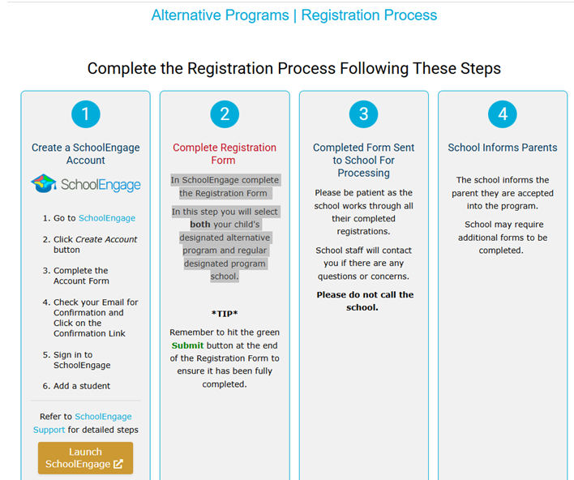

Slide 21

Transportation - Bussing
Currently, transportation is provided for French Immersion students
living in the communities of:
Rocky Ridge
Royal Oak
and English Program students who live in a designated school area.
Further transportation information will be forthcoming
in the Spring.
Notes:
Lesley
Bussing routes are set by the Calgary Board of Education.
We can accept your preference for AM/PM class however, none of these can be confirmed until the Spring.
Once registered, parents will receive an email from our school, with details regarding how to register for bussing (families living in Royal Oak and Rocky Ridge).
Link to Coded Minds (if anyone asks):
https://www.coded-minds.org/tuscany-isteam-learning-lab/

Slide 22
Welcome to Kindergarten – May 2025
Learn more about École Tuscany School
Meet Kindergarten Teachers
See Kindergarten Classrooms
Engage in literacy, mathematics and fine & gross motor activities with your child
Notes:
Laura
We will be holding a Welcome to Kindergarten event in person at the school in the spring. Parents and their registered incoming kindergarten children are invited to the school to learn see the classrooms, meet some of the teachers, and engage in some fun activities together which will guide practice and reinforcement at home over the summer before they begin coming to school in September. This event is usually held in late May and in April, if you are registered for kindergarten at Ecole Tuscany School, you will receive an email from the school letting you know the details of the event.

Slide 23

Questions...
Notes:
Lesley
After questions thank parents for attending.

