Slide 1
2025 School Planning

Slide 2
2025 School Planning
Welcome
Agenda
    Presentation
    Q & A
    Gather feedback
    Meeting evaluation

Slide 3
2025 School Planning
The purpose of this meeting is to:
  Share information about school planning at École Tuscany School
  Gather feedback that may be considered in making future school planning decisions

Slide 4

Notes:
What is School Planning?
This video was developed to provide you with more information about the school planning process.

Slide 5
How is Our School Development
Plan Used?
Guides ongoing assessment and review of goals and actions.
Our school development plan is the driver for closing learning gaps and informs:
    Instructional strategies
    Professional learning
    School structures and processes for learning
    Resources to improve student learning
    Data-informed decision making
Notes:
Establishing and posting the plan is just the beginning. Staff work throughout the year to implement the actions and achieve the goals identified in the school development plan. Part of that work is also making sure actions are visible to the school community, including parents. Throughout the year, the school development plan will inform many aspects of our work, such as:
Instructional strategies
Professional learning
School structures and processes for learning
Resources to improve student learning
Data-informed decision making

Slide 6
School Development Plan –
School Goal
Student foundational skills in literacy and mathematics will improve.

Slide 7
School Development Plan –
Outcome
Outcome 1:
Students will improve in phonological awareness and decoding skills in English and French.
Outcome 2:
Student procedural fluency will improve through a focus on number sense.

Slide 8
School Development Plan –
Outcome Measures
Outcome Measures
Provincial Numeracy Assessment: Gr. 1-3
CC3, LeNS, PAST and RAN assessments
CBE screeners including new decoding screener
Report Card Data – Reading and Number
Perception data from Our School survey, CBE Student survey and Alberta Assurance Survey, Parent engagement surveys
Data Dashboard data including demographics, EAL, attendance

Slide 9
School Development Plan –
Data for Monitoring Progress
Data for Monitoring Progress
Intervention Groups – tracking sheet
EAL Benchmarks Analytics
Teacher perception data: Teacher confidence in implementing University of Florida Literacy Institute and MathUP
Admin check ins for Tier 1/Universal supports non-negotiables from Continuum of Supports
PLC pre and post assessments as well as teacher individual and group reflection on strategy success

Slide 10
School Development Plan –
Actions
Learning Excellence Actions
Early years (K-2) explicit instruction using UFLI
Grade 3-5 explicit instruction using Words Their Way and leçons par phoneme (French language scope and sequence)
Small group reading instruction to support all readers with symbol-sound correspondence, phoneme-grapheme correspondence, comprehension, fluency and vocabulary development
Building, modeling and using classroom sound walls
Using visual models such as number lines, base-ten blocks and other mathematical tools and manipulatives to support students’ conceptual understanding in mathematics
Daily use of mental mathematics strategies to improve mathematics fluency: Power of Ten, Daily 30s, Problem of the week, Math Talks/Number Talks
Implementing Minds on Math Activities and Performance Tasks from MathUp

Slide 11
School Development Plan –
Actions
Well-Being Actions
Making intentional connections between the four Zones of Regulation, the Medicine Wheel concepts, and the 4-point scale of seed, sprout, sapling and tree, to help students identify when they are becoming dysregulated
Continue to explicitly teach self-awareness and self-management strategies
Provide students with opportunities to work through a school-wide problem solving model that support social emotional learning
Continuing Roots of Empathy Programming
Leadership students to design and help implement clubs and co-curricular activities
Utilize MindUp Curriculum and concepts with targeted students

Slide 12
School Development Plan –
Actions
Truth & Reconciliation, Diversity and Inclusion Actions
Using the Medicine Wheel concepts to help students understand the importance of having balance between the mind, spirit, body and heart.
Intentionally choosing more diverse texts to support learning in the classroom so that students see their cultures and themselves, represented more frequently and more authentically
Continue our work with Elder Shirley and begin school wide sharing circles
Continue a strong focus on land-based teaching and learning and connecting curricular areas to learning on and from the land

Slide 13
Questions?
We’ll take a few minutes to answer questions about our school development plan.
Notes:
Pause at this slide until your Q&A is finished.
You may want to remind participants that this Q&A is to clarify anything that was unclear in the presentation up to this point and that there will be an opportunity to provide feedback after the presentation.
It is recommended that someone keeps time.

Slide 14
Our School Budget
Our school received $4,081,314 in 2024-25 to provide a quality education to our students and meet the goals in our school development plan (SDP).
At least 75 per cent of budgeted funds covers staffing and the remaining portion covers instructional and operational supplies.
Notes:
Most aspects of a school development plan are independent of the school budget. However, budget may affect how we implement a school development plan. For instance, if a school development plan identifies English language learning as the focus, the school could elect to allocate part of their budget to hiring a teacher to support English language learners and build teacher capacity in this area. In other cases, schools may also consider parent fundraising to enrich supports currently available (e.g., expand the collection of dual language books in the school’s learning commons).
The vast majority of funding goes to staffing. The remaining portion pays for supplies and other resources.
[Add more detail about the instructional and operational supplies at your school.]

Slide 15
Our 2024-25 School Budget
Our student enrolment for the current year is 593.
RAM Allocations
Per School Total |  | $ 1,067,090
Per Student Total |  | $ 3,014,224
Total RAM Allocations |  | $ 4,081,314
RAM Deployment | Scenario A
Organization |  | FTEs
Teachers | $ 3,145,014 | 28.7
Support Staff | $ 416,683 | 7.6
Administration | $ 353,025 | 3.9
Total Staffing | $ 3,914,722 | 40.2
Supplies/Other | $ 166,592
Total RAM Deployment Plans | $ 4,081,314
Notes:
Populate the table with your school budget information for 2024-25. You can find this information within the Messaging tab of your 2024-25 Fall RAM.

Slide 16
Our 2024-25 School Fees
We will consult with families by outlining proposed activities for the upcoming year that may require a fee for cost recovery.
Field trips such as Royal Tyrell museum, Storybook Theatre, SAM centre, Heritage Park, Safety City, Butterfield acres
Activities such as swimming lessons
In-school experiences such as Teacher’s Pet and the Astrodome
Notes:
You may want to discuss some of the following topics:
How fees, fundraising and budget are interconnected.​
How parent society fundraising $s were used to lower/eliminate some fees​
What the major categories of fees were at the school​
School-based fees vs. central CBE fees (e.g., transportation, noon supervision)​
Average fee per student (per grade?)
Differences when compared with last year’s school fees

Slide 17
Our 2024-25 School Fees
2023-24 Report to Parents on Fees
https://tuscany.cbe.ab.ca/documents/567b9882-7bb2-430f-93f1-f5ef1bbd589d/Report%20to%20Parents.pdf

Slide 18
Questions?
We’ll take a few minutes to answer questions about our school budget and fees.
Notes:
Pause at this slide until your Q&A is finished.
You may want to remind participants that this Q&A is to clarify anything that was unclear in the presentation up to this point and that there will be an opportunity to provide feedback.
It is recommended that someone keeps time.

Slide 19
Gathering Your Feedback
Feedback is important as we consider school planning. When students, families and staff work closely together, students achieve greater success in their learning.
We’d now like to gather your feedback on some specific questions.
Notes:
Please provide your comments and thoughts.
TIP: Prepare some ‘probing questions’ beforehand to help encourage and guide the conversation. If you are holding a virtual meeting, you can also consider using the Teams Polls to gather feedback on specific questions – you can do this at various points during the presentation/session.
TIP: Have someone take notes to capture comments and feedback.

Slide 20
Next Steps
We will update our school website by April 30th with:
    A summary of feedback gathered at tonight’s session
    A meeting evaluation summary
    Feedback from the survey
    Share information about student results and the school development plan at our September, 2025 school council meeting.
    Our updated school development plan will be posted on our school website by Nov. 30, 2025.

Slide 21
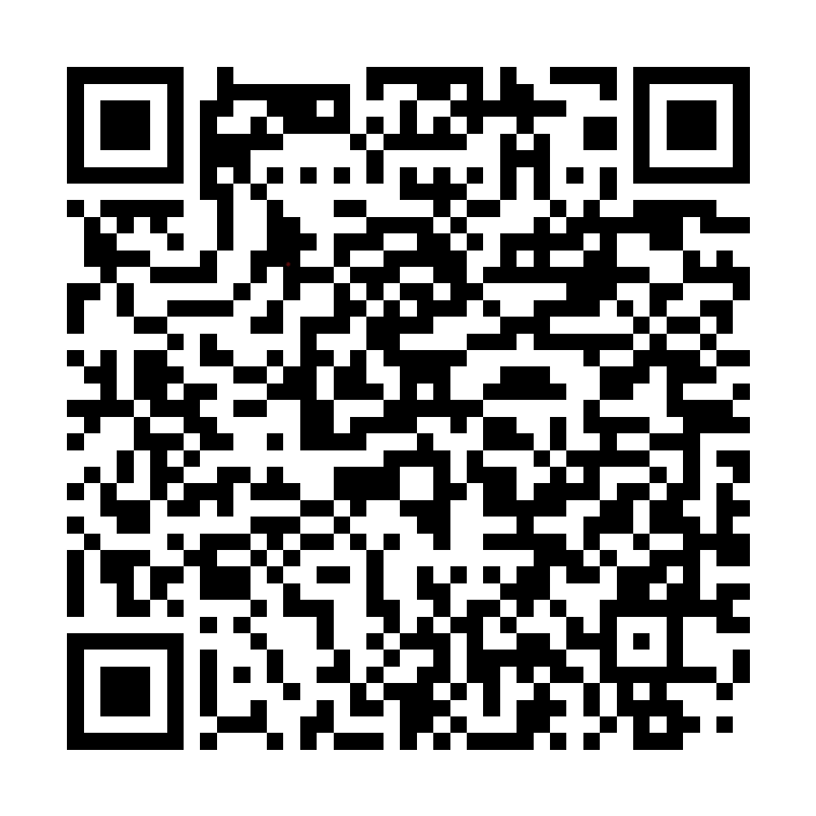
Wrap-Up
Thank you for your participation!
Please take a few minutes at this time to share your feedback about this meeting.
Notes:
We want to make sure our meetings meet your needs and expectations. That's why we are asking for your feedback on this meeting. Your feedback is the only way we will know what we're doing well and what we can improve at future meetings. So please do take a few minutes to share your feedback. We will share a summary of responses on our website later this spring.

